Slide 1
The Foundational Economy in Practice in Social Care
Adrian Roper

Slide 2
The story of social care
PRE-1948
Care provided by:
Families
Neighbours
“Societies”
Charities
COMMUNITY:
Citizens
Fragility
Inequality
1948 – 1980s
Care provided by:
Councils
NHS
STATE:
Officials
Bureaucratic
Decent wages
1990 – 2010s
Care provided by:
Contractors
Personal Assistants
MARKET:
Business managers
Competitive waste
Low wages

Slide 3
The story of social care – a Fourth Way?
COMMUNITY
COLLABORATION
CO-PRODUCTION
VOICE & CONTROL
SUPPORTING
SUPPORTING
LOCAL
LONG-TERM
RECIPROCITY
MARKET
STATE
ADEQUATE FUNDING
ADEQUATE FUNDING

Slide 4
Building citizens and communities into the system
Transforming assessments into “what matters” conversations
Giving decision-making authority to those closest to the person
Valuing people as contributors and their networks as assets
Nurturing community-run groups and activities
Organising services on a locality basis
Promoting “user led services” and “democratic membership”

Slide 5
Building citizens and communities into the system
Example: Cartrefi Cymru
Walking the talk of Welsh care laws: co-production and added value
Becoming a multi-stakeholder community-building co-operative
Innovative commissioning in Powys

Slide 6
Creating trusted supplier relationships and reducing competitive waste
Buying for the long-term - and stopping endless tendering
Awarding contracts on a locality basis
Helping to solve your providers’ problems - for reciprocal benefit
Involving providers in your processes for learning and improvement
Identifying the value of providers by their behaviours – not their tenders

Slide 7
Creating trusted supplier relationships and reducing competitive waste
Example: Gwynedd County Council
Re-designing home care into problem-solving locality teams
Measuring things that matter – not “time and task”
Valuing the workforce

Slide 8
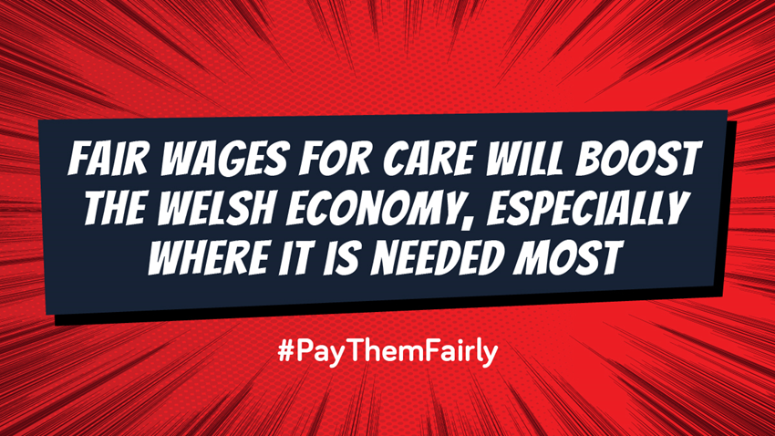
Campaigning for better funding - and wages
“A Labour government after May's Senedd election would ensure all carers in Wales are paid the Real Living Wage”
First Minister, Mark Drakeford

Slide 9
Thanks
adrian.roper@cartrefi.coop

